Slide 1
CASSA
2019
Strategic Management
and…
Data to Support Student Well-Being
Presented By: CMCLeadership and Barragar
.
Notes:
Catherine and Berni to Introduce one another

Slide 2
Objectives
Executing the improvement of well-being in your strategic plan
Setting the table (planning frameworks)
What’s on the menu? (District data sources)
What are the success considerations for monitoring student well-being?
Notes:
[Add notes]

Slide 3
Improving students’ achievement and well-being is the fundamental role of Educational Leaders
Notes:
Fundamental role of leaders everywhere and we are always striving for ways to refine our practices.
We all want to stay the course with so many distractions happening everywhere.
There are so many priorities that we are trying to achieve the strong district work brought focus into what we are trying to accomplish.

Slide 4
Commissioned By Directors of Education (CODE)
Uses evidence from many sources on the nine characteristics of high performing school districts
Notes:
In Ontario (over 8 years ago) there was controversial politics happening at the time that recommended we remove a layer of senior leadership. Lets focus on what works in school systems.
Commissioned Dr. Ken Leithwood who has been doing work in Leadership in Ontario for a many years. Author of the Ontario Leadership framework and additional research. Lets talk about what really works.
Google “Leadership in Education” and his name will be number one.
I had the opportunity as a Director at the time to take a lead in making this happen.
Table of what the District Practices are.
9 Key characteristics that research shows districts enact that support student learning.
Also a vision of what we should be striving for.

Slide 5
Characteristics
Provide
Coherent Instructional Guidance
Mission, Vision
and Goals
Align budgets, personnel/polices and uses of time with district mission, vision and goals
Establish, broadly shared mission,
vision and
goals
founded on ambitious images
of the educated person.
Build district and
school capacity - Seek out and use
multiple sources
Create learning oriented improvement processes
of evidence
Advocate
for and
support
a policy-governance approach
to Board
Nurture productive working relationships with staff and stakeholders
Use a comprehensive performance management system for school and district leadership development
Provide Job Embedded Professional Development
Notes:
Mission, Vision and Goals
Ensure transparent visioning/direction setting process is carried out
Consult extensively about district directions as part of the process
Spend sufficient time to ensure that the mission, vision and goals ( direction of the system is widely known)
Model the priorities
Embed district directions in improvement plans, principal meetings and other leadership interactions
Provide Coherent Instructional Guidance
Adopt a service orientation towards schools
Align curricular goals, assessment instruments, instructional practice and teaching resources
Insist on ambitious goals for teaching and learning
Advocate for attention to the best available evidence to inform instructional improvement decisions
Expect schools to focus on needs of individual as well as groups of students
Encourage staff to be innovative
Build district and school capacity-Seek out and use multiple sources of evidence
Use data from all available sources to inform decision making
Insist on the use of the best available research
Encourage collaboration with the data
Provide training on the use of data with your principals and staff
Interactions with trustees should be based on sound evidence.
Provide Job Embedded Professional Development
Provide PD opportunities for teachers and school level leaders in context
Align content of PD with capacities needed for district and school improvement
Require staff and growth plans be aligned with district and school improvement priorities.
Hold staff accountable for applying new capacities.
Align budgets, personnel/polices and uses of time with district mission, vision and goals
Resources with district and improvement goals
Align personnel procedures and organization structures with district goals.
Give principals autonomy in hiring teaching staff
Assist and expect schools to allocate instructional resources equitably.

Slide 6
Mission, Vision and Priorities
Ensure transparent visioning/direction setting process is carried out
Consult extensively about District directions as part of the process
Spend sufficient time to ensure that the mission, vision and goals, direction of the system is widely known
Implementing the strategic priorities
Monitor the multi-year strategic plan (MYSP)

Slide 7
Advocate for the support and a policy-governance approach to Board and Trustee practice
Encourage Trustees to focus on district policy and the achievement of the district’s goals and priorities
Encourage participation of the elected Board in setting broad goals for its use in fulfilling its policy-setting and policy-monitoring responsibilities
Regularly report to the Board progress in achieving these broad goals

Slide 8
Effective Board practices
Use the District’s beliefs and vision for student learning and well-being as the foundation for strategic planning and ongoing system evaluation;
Focus most policy making on the improvement of student learning and well-being consistent with the system’s mission and vision;
Develop policies and support staff decisions aimed at providing rich curricula and engaging forms of instruction for all students and eliminating those that do not.

Slide 9
Effective Board practices
Policy not operations
Effective and efficient policy
Relationships with senior staff, especially director/superintendent/director
general
Honoring the community’s voice
Aligning budgets with visions/strategic plans

Slide 10
An Effective Mission, Vision and Strategic Priorities
Transparently developed with multiple school and District stakeholders
Reflects parameters set by the province
Understood and shared by almost all staff
(Leithwood, K. (2011). Characteristics of High Performing School Systems in Ontario)

Slide 11
Authentic consultation
Provide input for our Strategic Plan!
To make sure we get our plan right, we need to hear from you!
We value your feedback in the planning process. Our MYSP input process is about:
Valuing voices
Gathering feedback
Identifying strengths and sharing new ideas
Coming together as a community
Your ideas will help us create our strategic plan.
Data that informs our plan

Slide 12
Student well-being
The primary work of district leaders is to improve the learning and well being of students. High performing districts make important contributions to the achievement and well being of students.
They openly make it a priority in their strategic plan and create high Performance expectations for students and staff.
Notes:
Reciprocal

Slide 13
Well-being is selected frequently as a strategic priority in Strategic Plans? How effectively do you track progress?

Slide 14
York
Regions
Priorities
Notes:
Lovely flower that outlines the priorities.

Slide 15
Thames Valley District School Board Priority
ACHIEVEMENT & WELL-BEING:
We engage in innovative learning experiences that promote excellence in student achievement and well-being
GOALS:
More students demonstrate growth and achieve student learning outcomes with a specific focus on numeracy and literacy
Staff will demonstrate excellence in instructional practices
Enhance the safety and well-being of students and staff

Slide 16
How do
you know?
Implementing
and monitoring
the…
multi-year
Strategic
plan
Presented By: Thames Valley District School Board – Kevin Lamoreux
.
Notes:
Implementing the Multi –Year Strategic Plan
Thames Valley District School Board
Kevin Lamoreux

Slide 17
What are the Trustees responsible for?
Ongoing review inclusive of MYSP annual summary review
Report regularly to the community on the progress of the MYSP
Monitoring the MYSP

Slide 18
How do Districts monitor their plan?
Operational plan with the look fors and goals and aligned to the MYSP
Monthly monitoring report to trustees
Policy review connected to the MYSP
The Directors Performance and alignment to the MYSP
Ongoing communication and updates provided to the trustees and to the community

Slide 19
Monitoring progress
The process of developing high priority goals to include in district strategic plans should include, at the same time, determining how progress with each of those goals will be measured.
Notes:
Louise to give examples of how you are measuring your goals in the DAP. (Qualitative and Quantitive)

Slide 20
Step One
Developed a planning framework that outlines
how the goals will be achieved, monitored and
evaluated during the implementation of the MYSP

Slide 21
Step Two
Developed the annual plan collaboratively with senior staff to help advance the priorities and the goals
Ensure the Boards planning is aligned to the MYSP

Slide 22
Step Three
Develop Improvement/Implementation Plans
The Annual plan is the implementation and monitoring for the MYSP
Once created the Board Improvement plan, School Improvement Plans and Department Plans are aligned

Slide 23
Step Four
Develop the Board Budget
The Board budget is a reflection of the
MYSP with the same strategic priorities and goals
identified and supported
Iterative process

Slide 24
Step Five
Data Collection
Embed data collection mechanisms and reporting
structures into all board and school operations
Notes:
School Climate, Every Student Counts Survey, Graduation Rates, EQAO, Graduation Rates, Employment Equity Data, Student Demographic Data, Regional Demographic Data , Attendance Data, Indicidences of Hate and Racism,

Slide 25
Discussion
In what ways is student well-being data being tracked in MYSP?
How effective is this?
Notes:
Flip chart the responses.

Slide 26
Anglophone East District School Boards Strategic Priority
GOAL: Allocate resources based on need so that every child has the same opportunity to learn.
STRATEGY:
To build an organization of common understanding and data driven decision making.
Notes:
Slide to be replaced

Slide 27
Questions of Principals each June
What is unique about your community?
What do you know about your Pupils?
What do you know about your Staff?
What do you need to teach pupils in your community?

Slide 28
Strategy
Perform multiple regression analysis to statistically
determine the predictive formula for an outcome
variable ( eg. student achievement based on multiple contributing variable – eg mental wellness, transiency)

Slide 29
Success criteria
You have linked goals to targets and targets to evidence about their achievement. (what data are you using?)
A solid strategic plan should evaluate the results of the plan during implementation
Flexibility about the actions to be taken to implement the plan as the plan unfolds.
Carefully align district resources, policies and procedures around the requirements and goals of the plan (Budget)
Notes:
Give some examples.

Slide 30
Our ultimate goal is that we have created a MYSP, that we will monitor through a collaborative process and communicate our progress transparently
Notes:
Discussion
What other outcomes are we looking for from this process.
Lets document of list of other intentions.

Slide 31
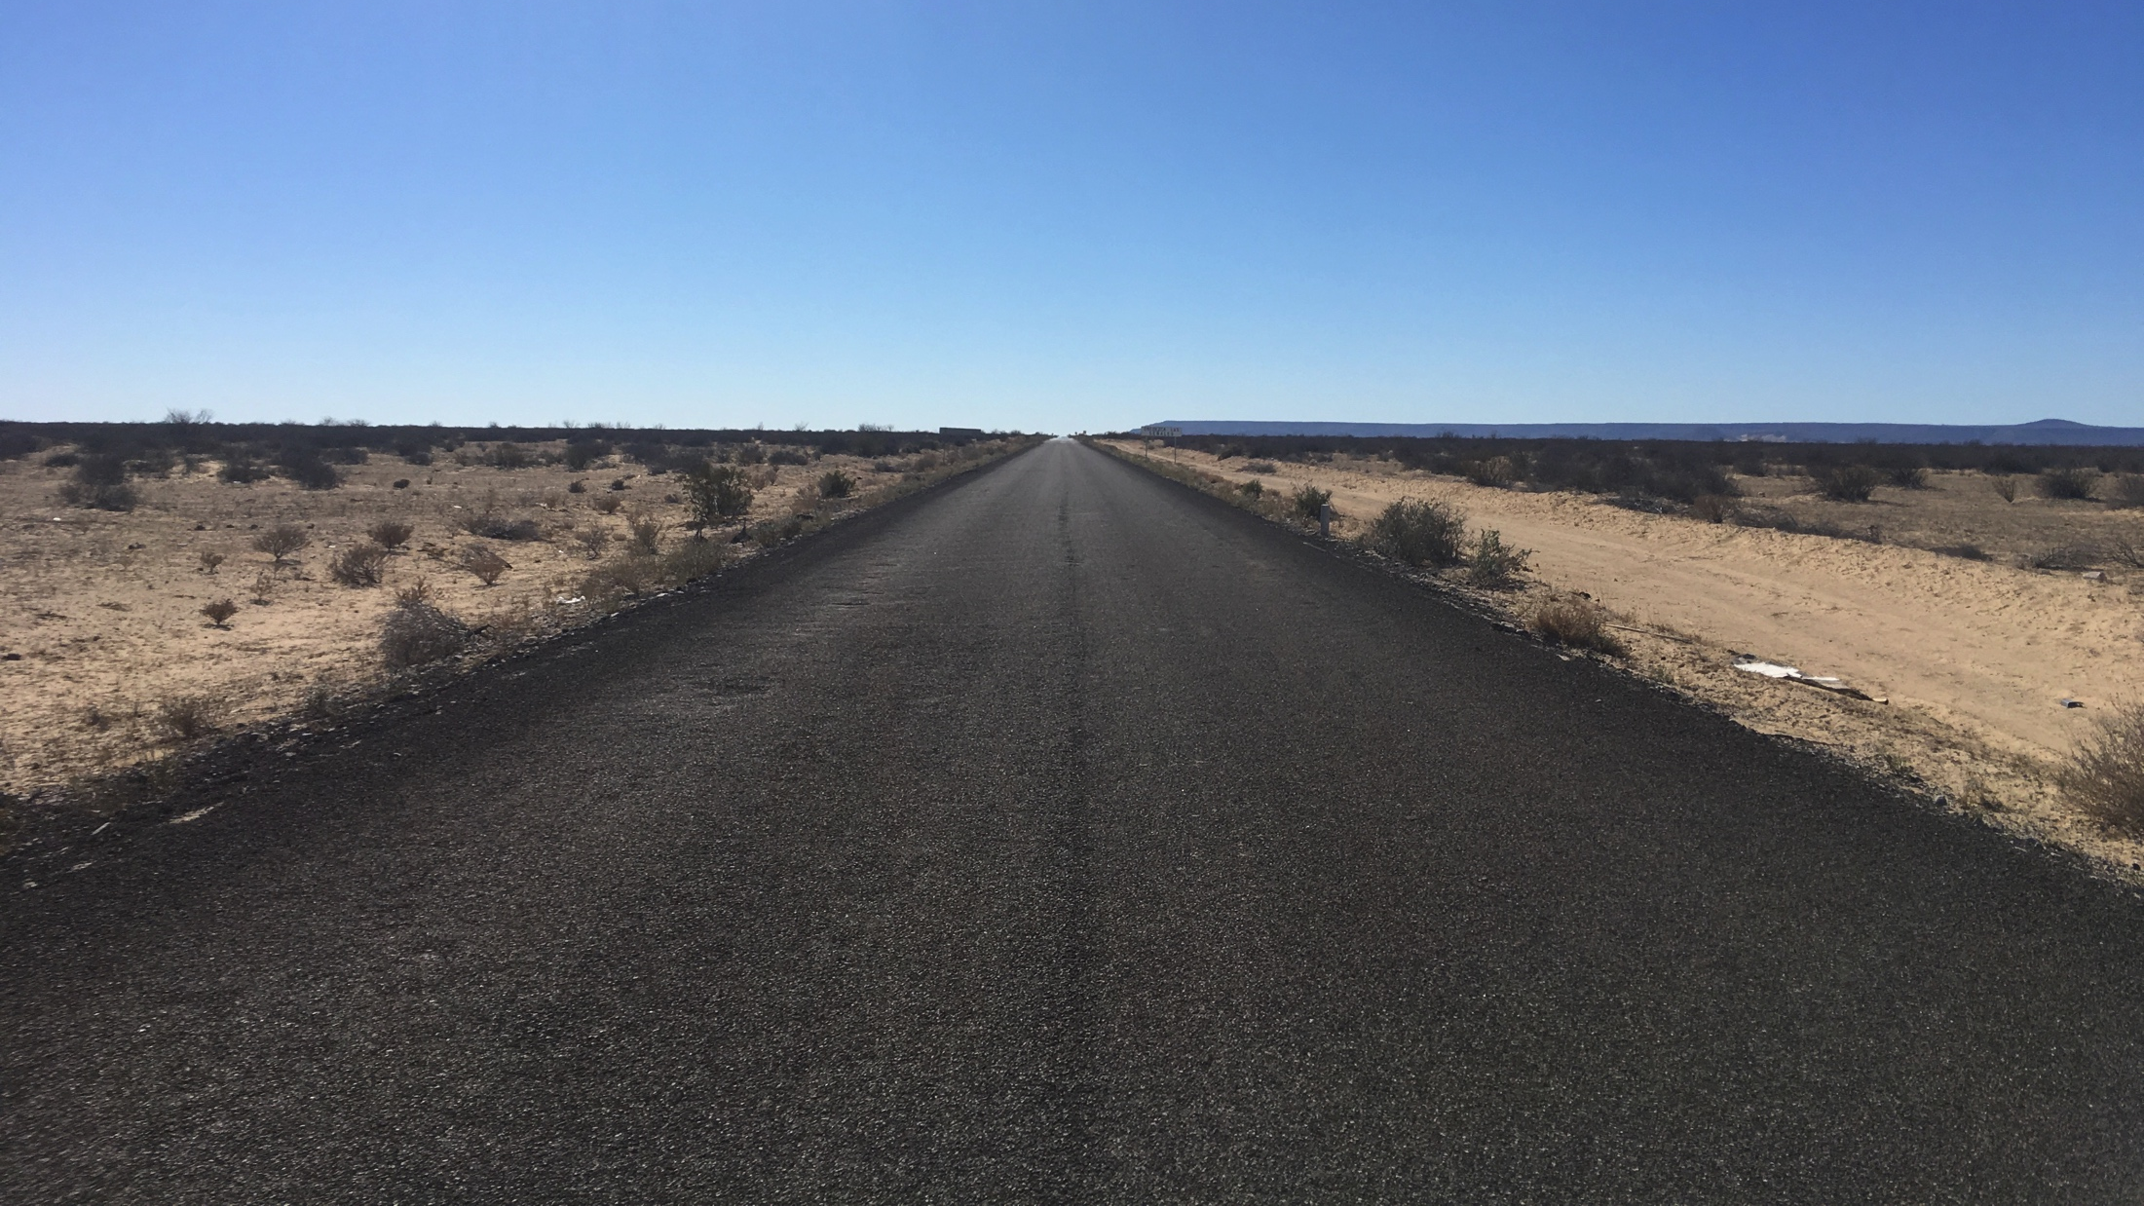
The road ahead will make a difference to those we serve…
Thank you!

