Slide 1
Holocaust Education in the Digital Age

Slide 2
The Azrieli Foundation’s Holocaust Survivor Memoirs Program
Who we are
What we do – books, films, outreach and more!
New interactive digital platform

Slide 3
Who we are
David Azrieli, founder
Established in 2005

Slide 4
Our Mission
The outreach mission of the Holocaust Survivor Memoirs
Program is to connect educators and students across
Canada to firsthand accounts of Holocaust survivors who
immigrated to Canada after the war. The Program is
guided by the conviction that these stories, the voices of
survivors, will cultivate empathy and compassion and
inspire action against hatred.

Slide 5

Survivor Memoirs

Slide 6
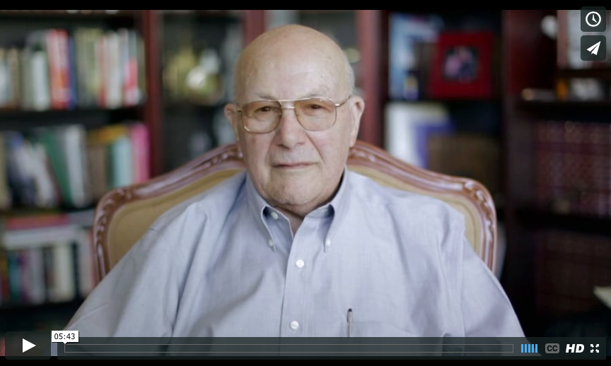
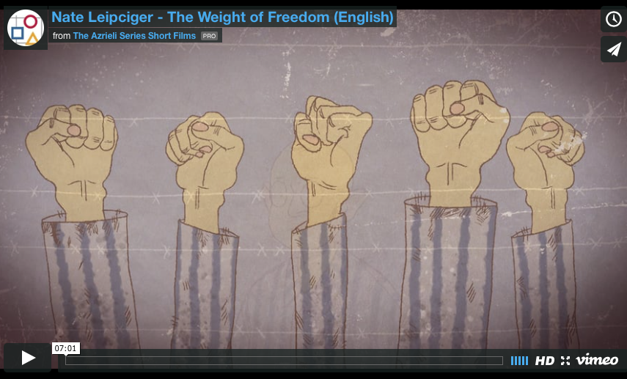
Azrieli Series Short Films

Slide 7
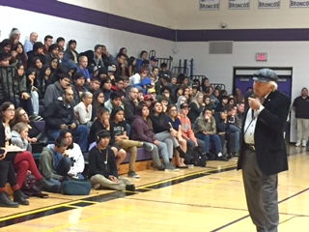
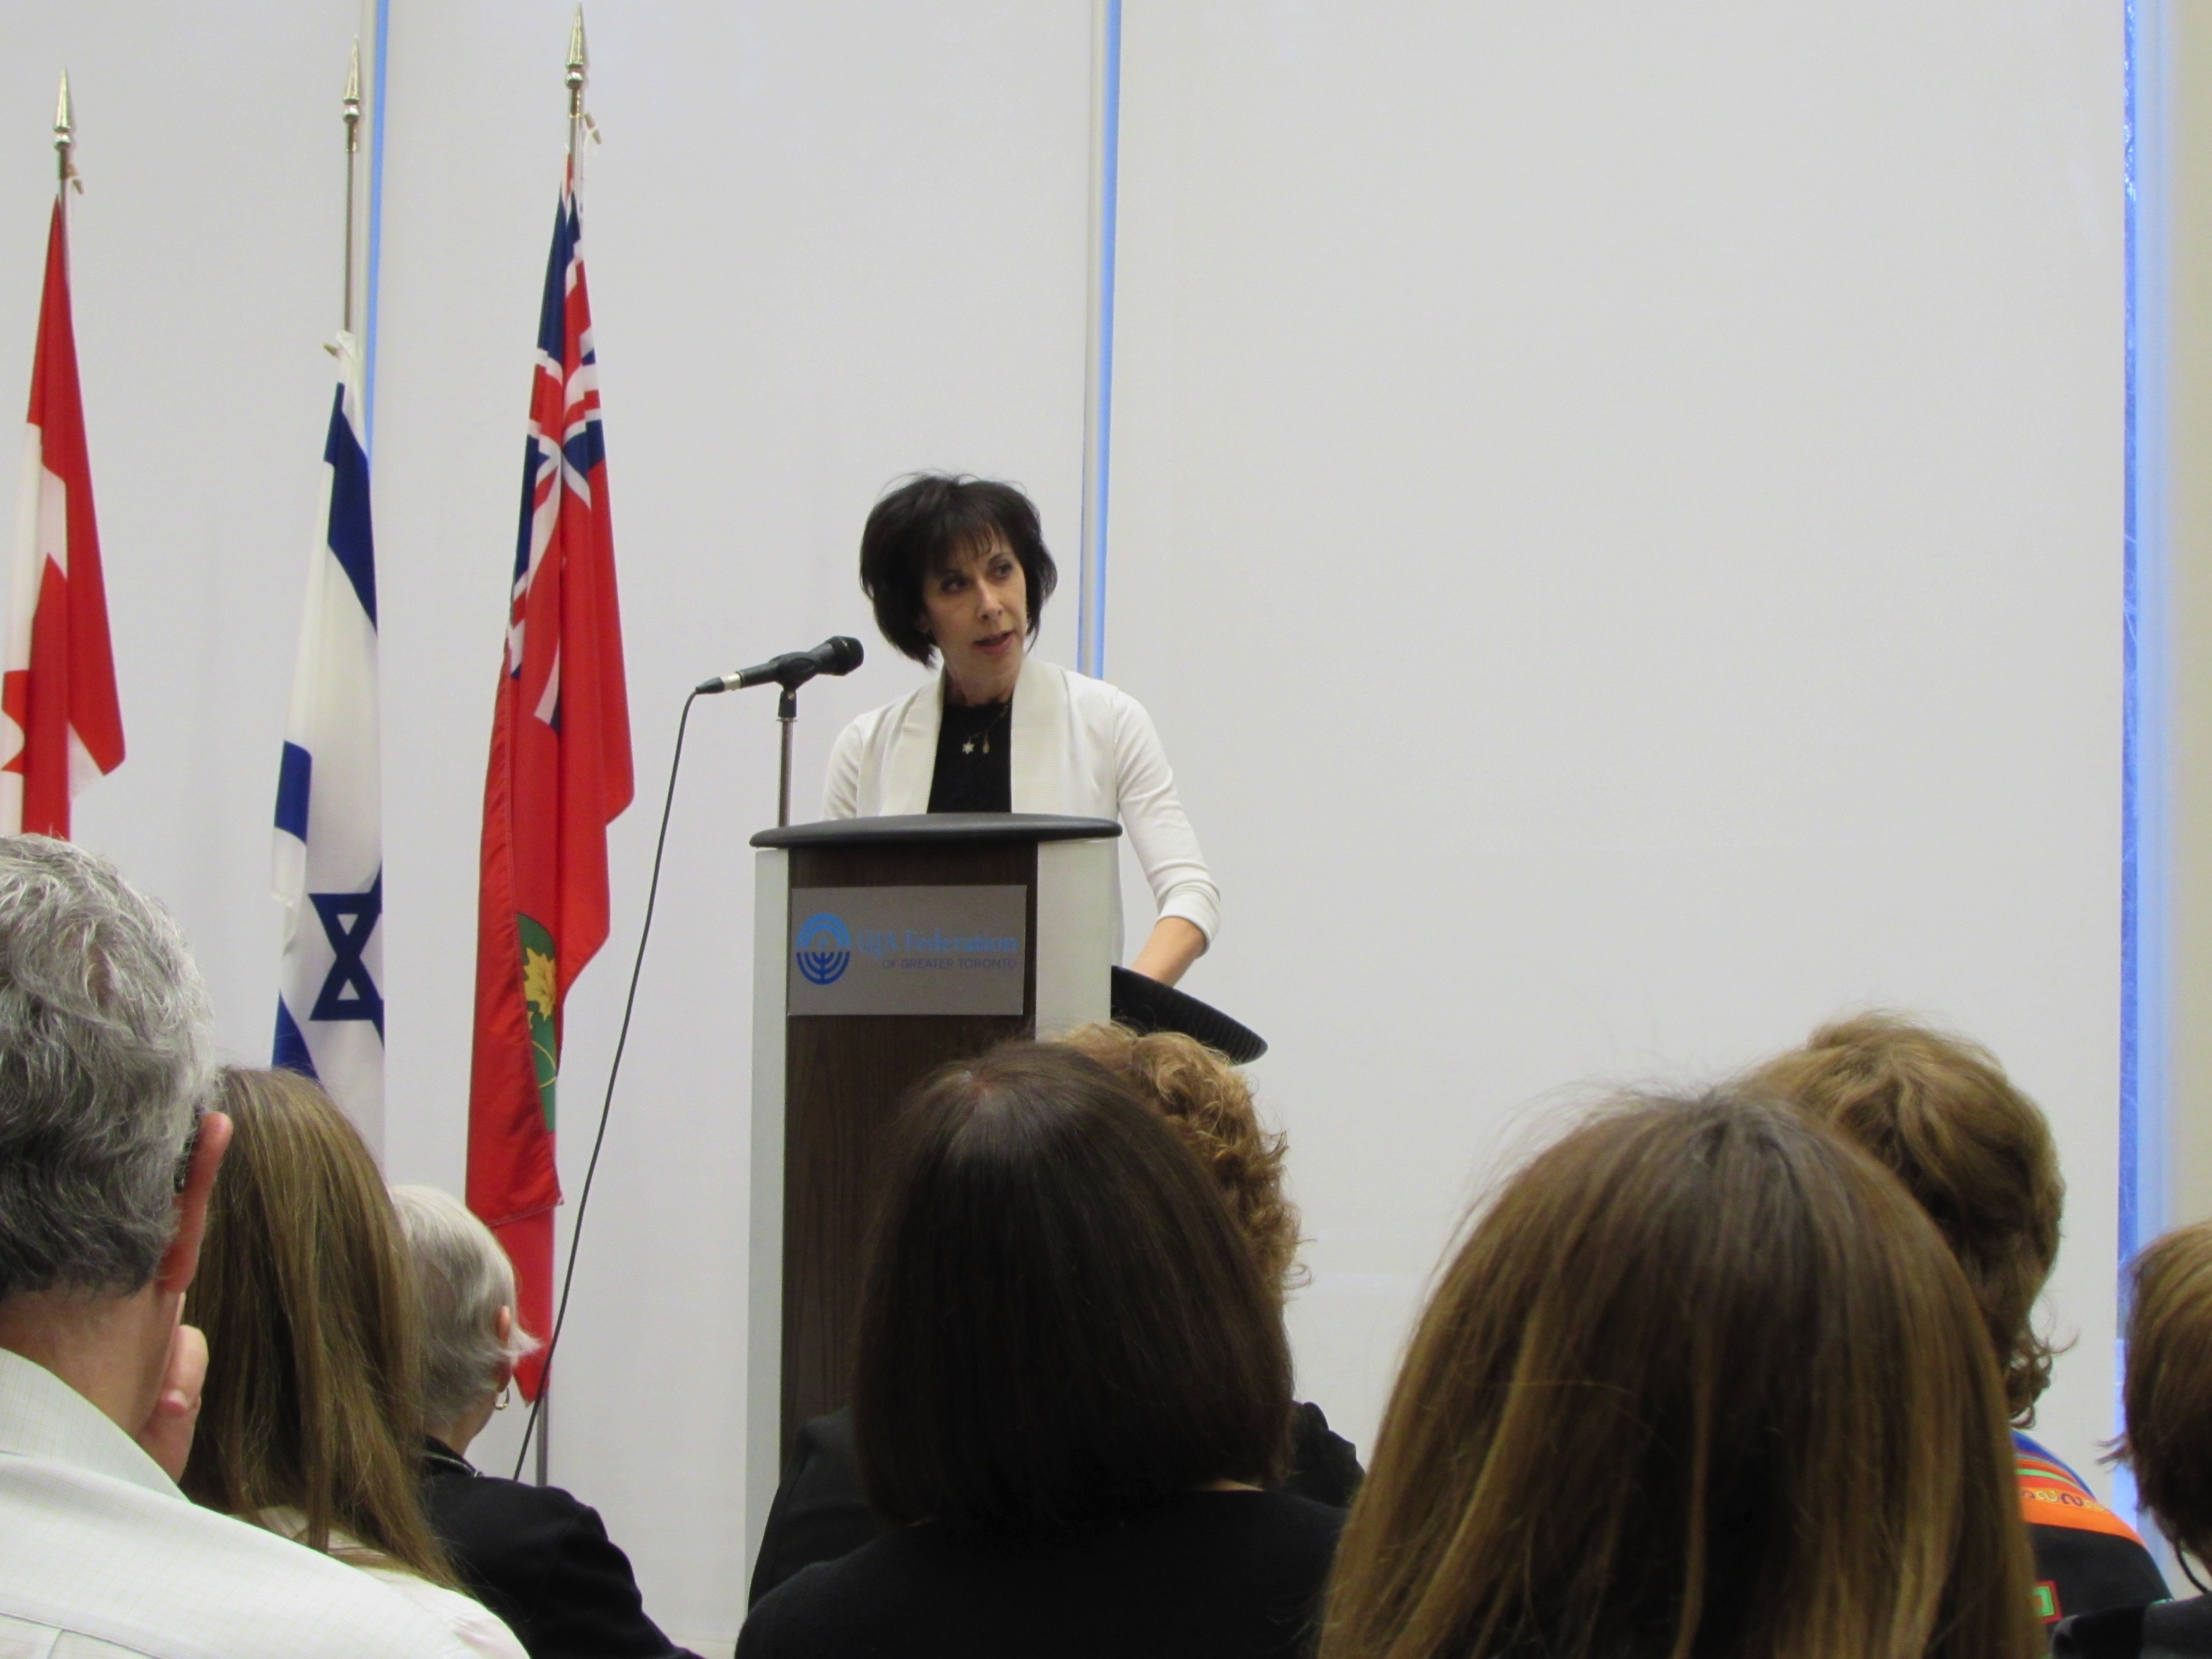
Outreach

Slide 8
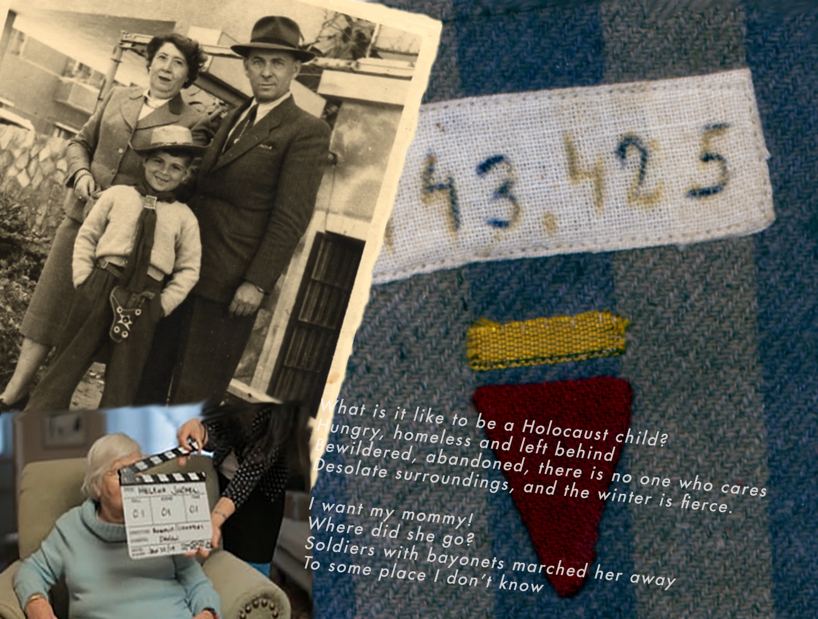

Slide 9

New Interactive Digital Platform
Accessible on our website: memoirs.azrielifoundation.org

Slide 10
Empathy generates great learning experiences.

Slide 11
Recap
All of our resources are free of charge to educators:
Book – French and English: order on our website
Films are downloadable at: vimeo.com/azrieli/videos
Re:Collection digital platform: accessed on our website
Outreach – across the country
Connect with us on Facebook: Azrieli Holocaust
Survivor Memoirs
Website: memoirs.azrielifoundation.org

Slide 12
"The Azrieli Foundation’s resources are eagerly sought by my students of many grades. These resources allow them to develop a very personal connection with those who survived the Holocaust, provides them with a deeper understanding of this history, and reinforces the importance of guarding our human rights.”
Larry Mikulcik
Curriculum Coach
Horizon School Division, Humboldt, SK
_____________________________________
“It’s up to my generation to prevent another Holocaust from happening, and it is stories like yours that help us do it.”
Eliza – John F. Ross Collegiate
Guelph, ON
Grade 10 History

