Slide 1


Integrated Data Management in
Special Education

Slide 2
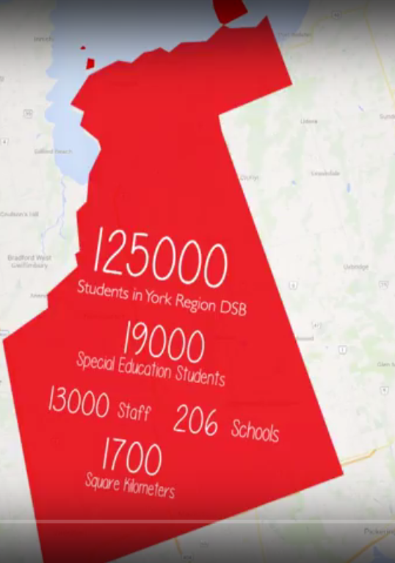
About the York Region DSB…
125000 students
19 000 Students with Special Education needs
1100 Special Education teachers
Over 200 Schools

Slide 3
Student Services in YRDSB
Inter-Disciplinary Team model that includes:
      Special Educuation Resource Teachers (SERT)
      Intervention Support Workers (ISW)
      Applied Behaviour Analysis Facilitator (ABAF)
      Work Experience Program coordinators (WEP)
      Blind/Low Vision Services
      Deaf/Hard of Hearing Services
      Student Services Coordinators
      Members from our 4 Regulated Health Professionals groups
    Psychological Services
    Speech-Language Pathology Services
    Occupational and Physical Therapy Services
    Social Work Services
Notes:
To coordinate services for students, family and staff, the YRDSB uses an Inter-Disciplinary Team model that includes:

Slide 4
It all began with…
Many departments working together to support students with Special Education needs
The realization that work was being duplicated
An understanding that our solution needed to be
  Accessible – to staff and families and across devices
  Linked to our SIS – Trillium
  Electronic
  Streamlined
  Efficient

Slide 5
Moving Forward…
Teams had their own applications
Difficult to manage
Difficult to maintain and update
Confidentiality and privacy worries
Notes:
The Process:
Collected requirements from all stakeholders
Completed the RFI/RFP process
Decided on a 2 envelope system
Tested “Sandboxes”
Made the decision on a Vendor

Slide 6
The Decision…
  Scalable
  Flexible
  Efficient
  Secure
  Configurable
  Ongoing support
Notes:
SIS is Trillium
Do not need to use PowerSchool to integrate the PowerSchool Special Education management software
Understanding Special Education in Ontario
Providing guidance to streamline processes
Recommendations for document templates
Enhancing student profile information

Slide 7
Our Document Templates
Historical/Legacy Documents
Growth Plans
In-School Team Records
Referral Documents
IPRC Documents
IEP Documents
Consent Documents
Professional Reports
SEA Claim Documents
Case Notes
Severity of Needs
Summary of Involvement Records
Special Transportation Requests
Work Experience Requests
Threat Assessment
Electronic Records Management

Slide 8
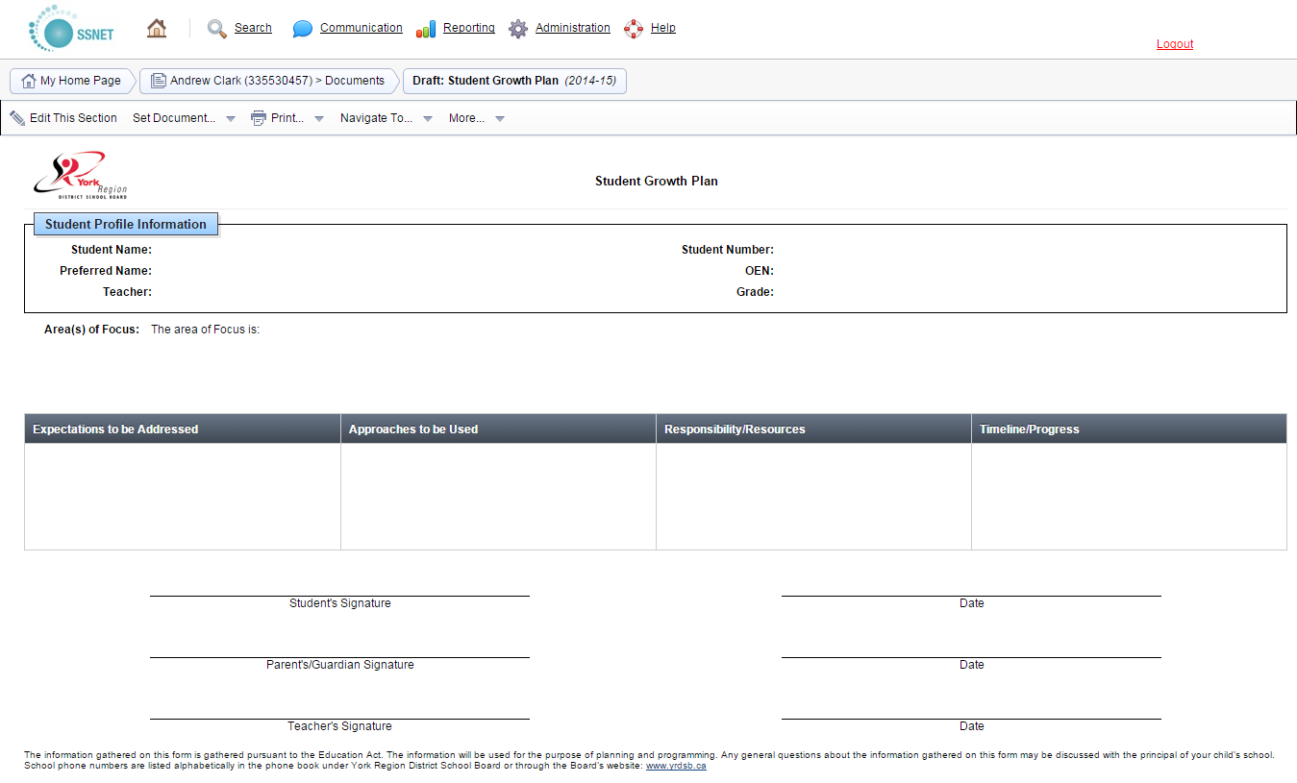
Growth Plan

Slide 9
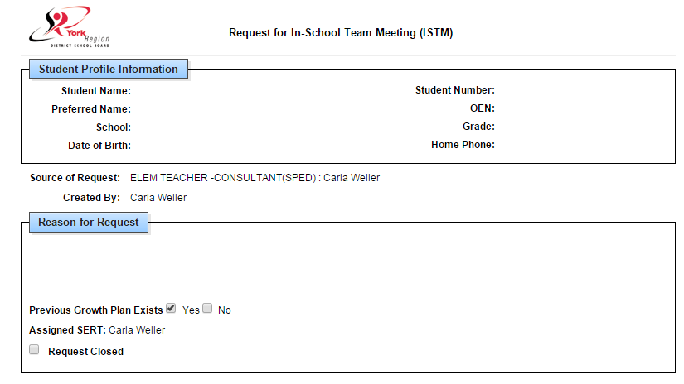
In-School Team Requests
Notes:
Request
Invitation
Record

Slide 10
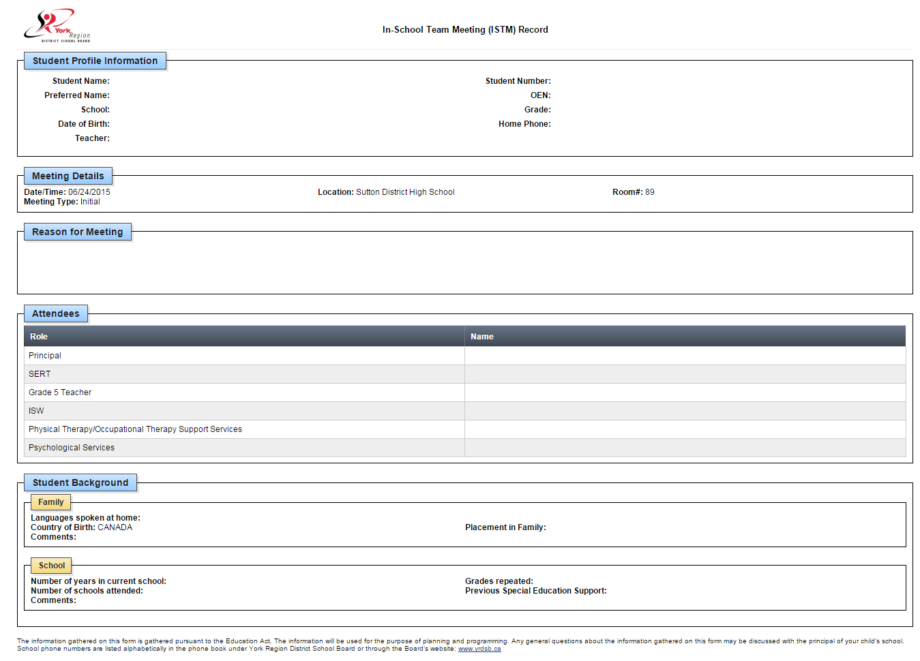
In-School Team Record
Notes:
Messaging system

Slide 11
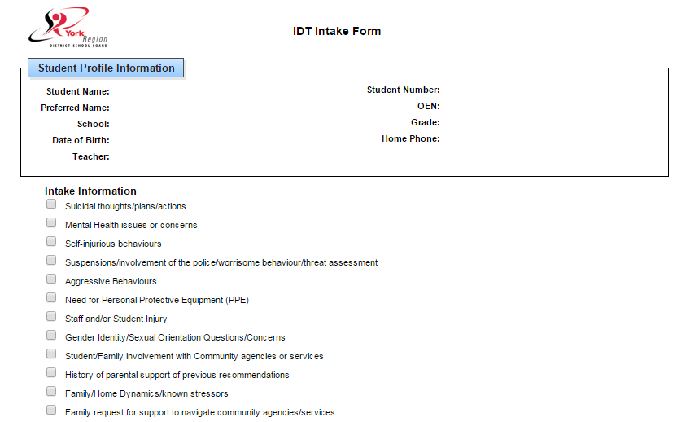
Referral Documents
Notes:
Messaging system

Slide 12
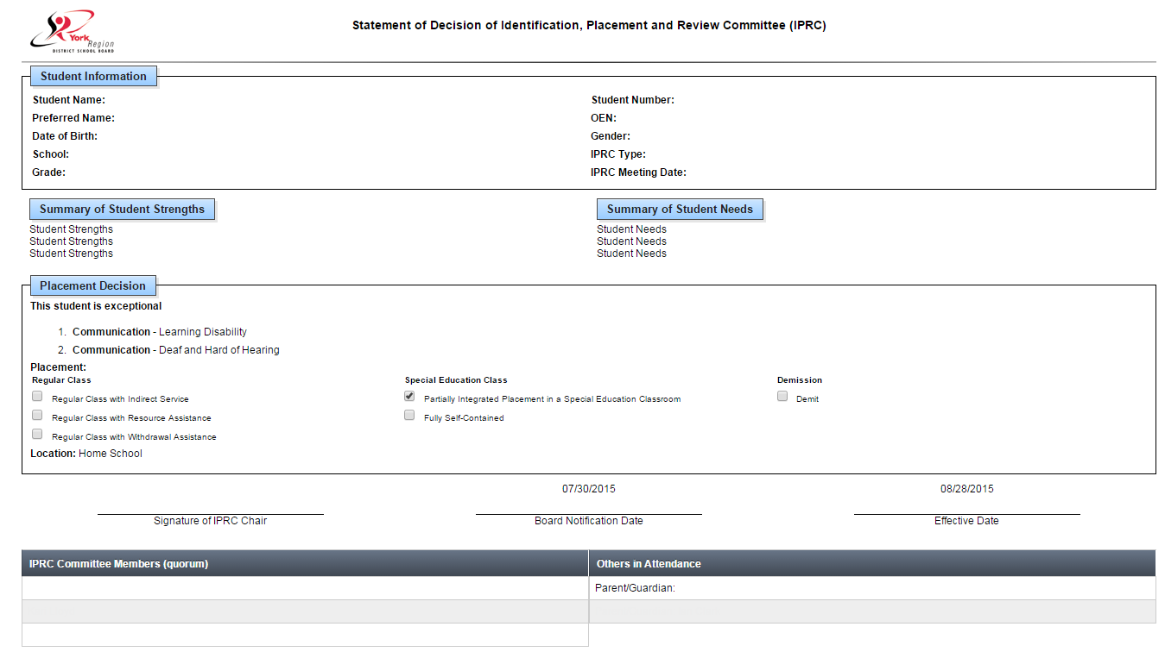
IPRC Documents
Notes:
Electronic submission
More reliable, secure
No risk of lost docs

Slide 13
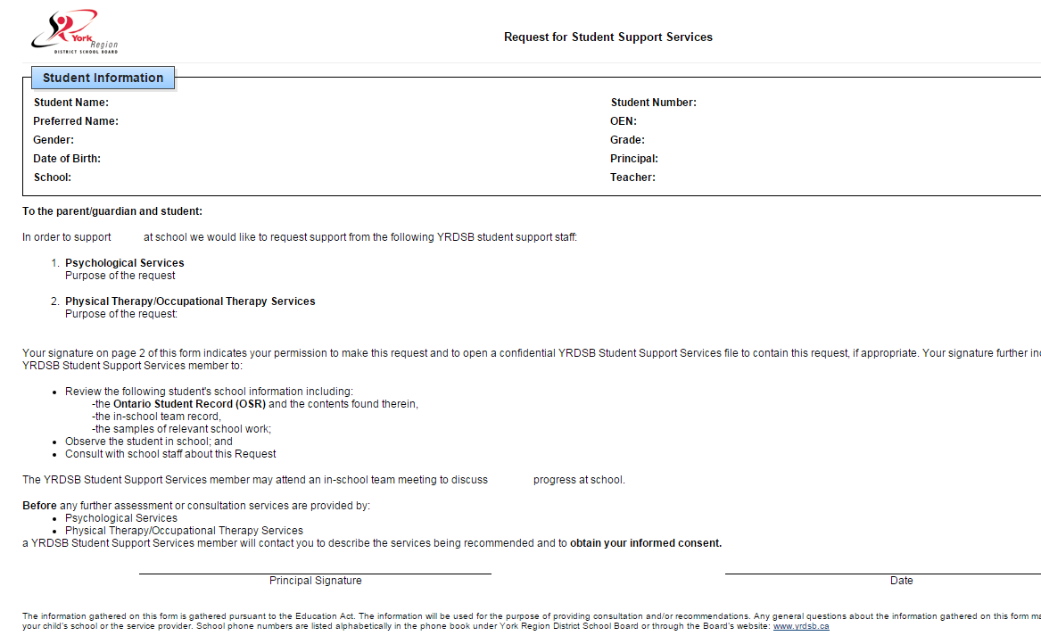
Consent

Slide 14
The IEP
Student Information
Sources Consulted
Accommodations
Program Pages
Transition Page
Report to Teachers
Attachment to the Report Card
Notes:
Maximus – reviewed our current documents, looked at Ontario standards, helped us develop a template that was efficient, easy to use, and ensures student information is relevant, up to date, editable.
Revision documents
Messaging system

Slide 15
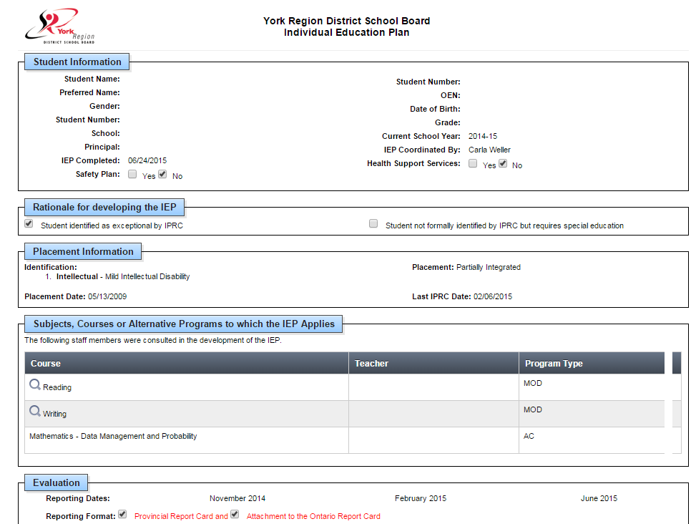
The IEP

Slide 16
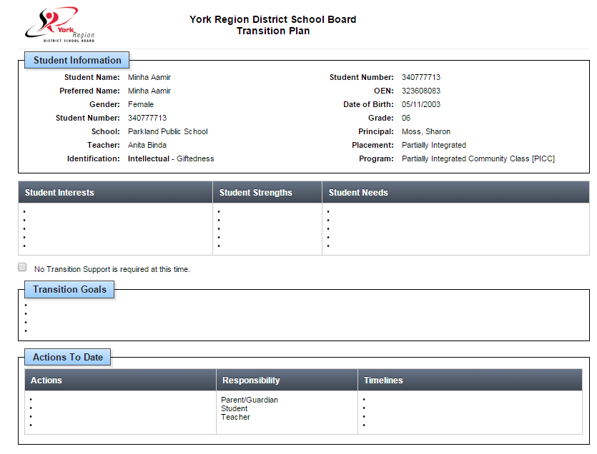
Transition Plan

Slide 17
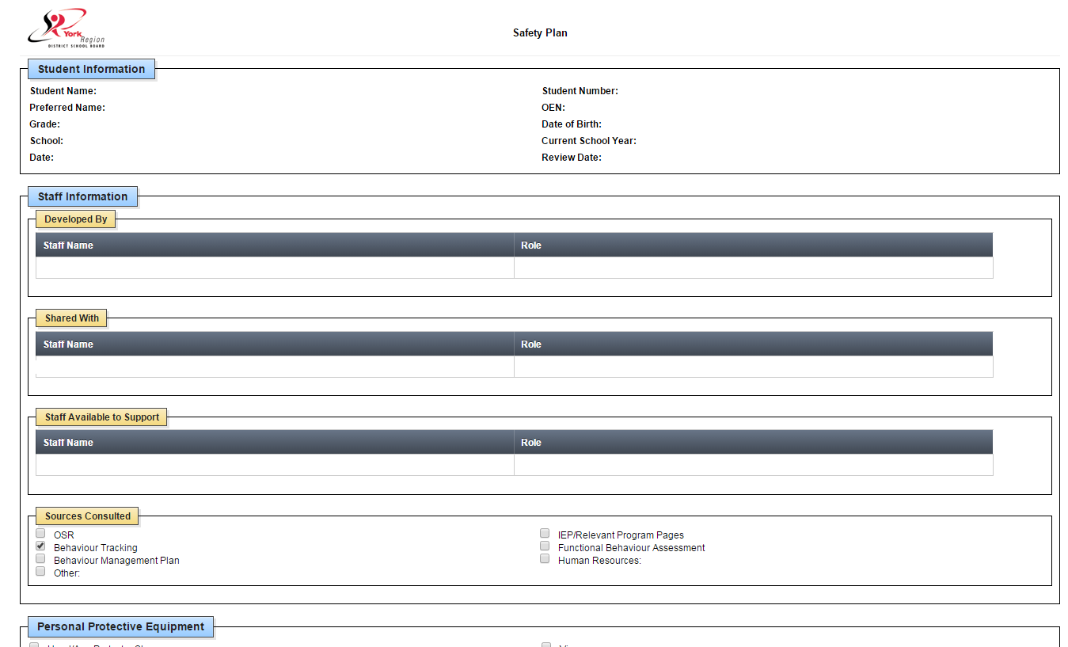
Safety Plan

Slide 18
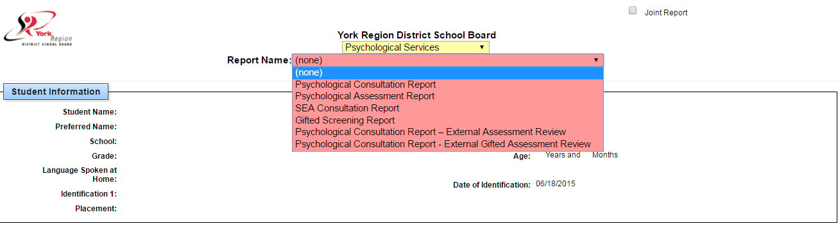
Professional Report
One common template used by all disciplines

Slide 19
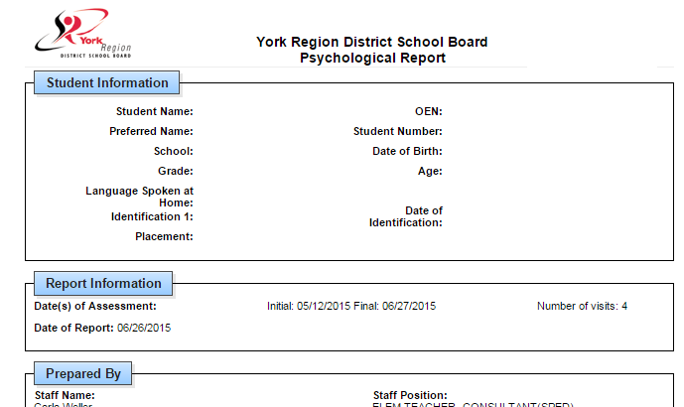
Professional Report

Slide 20
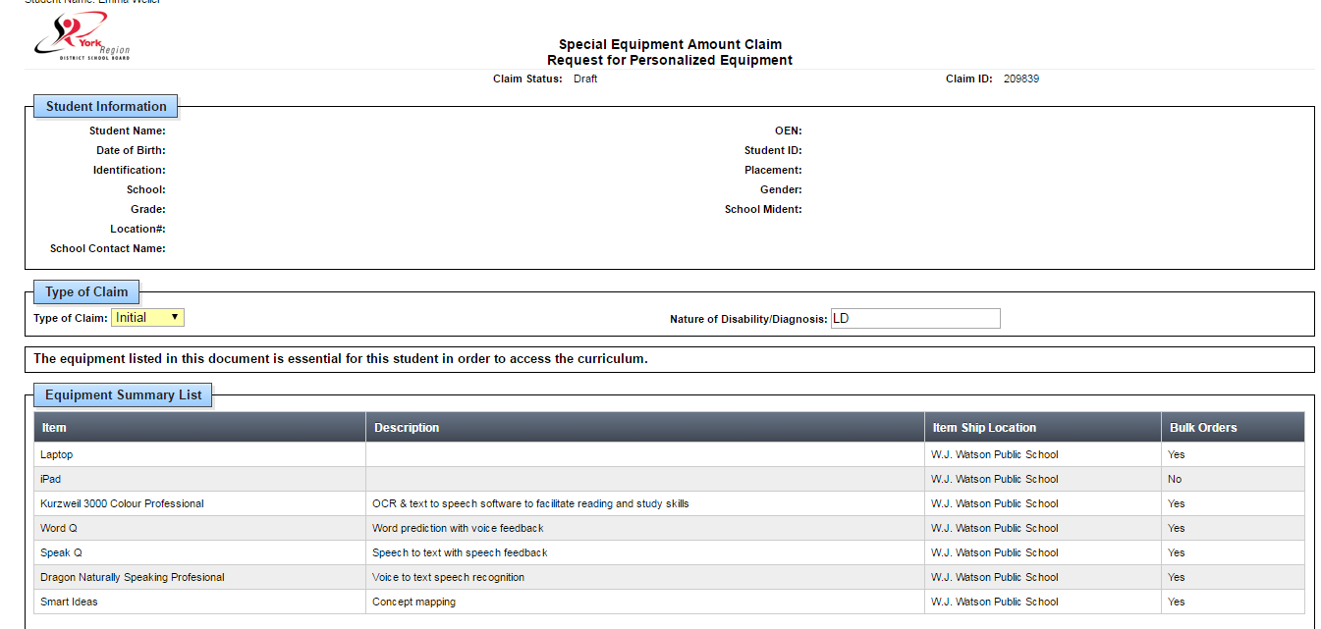
SEA Claim

Slide 21
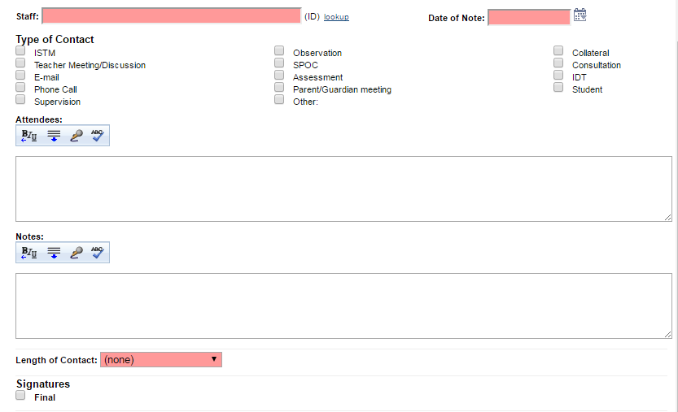
Case Notes

Slide 22
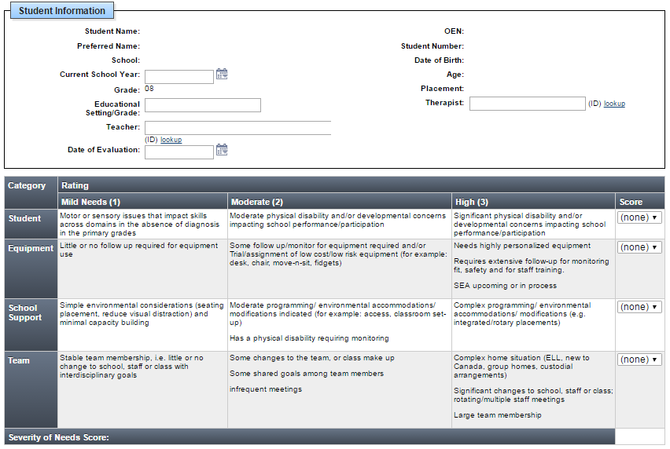
Severity of Needs

Slide 23
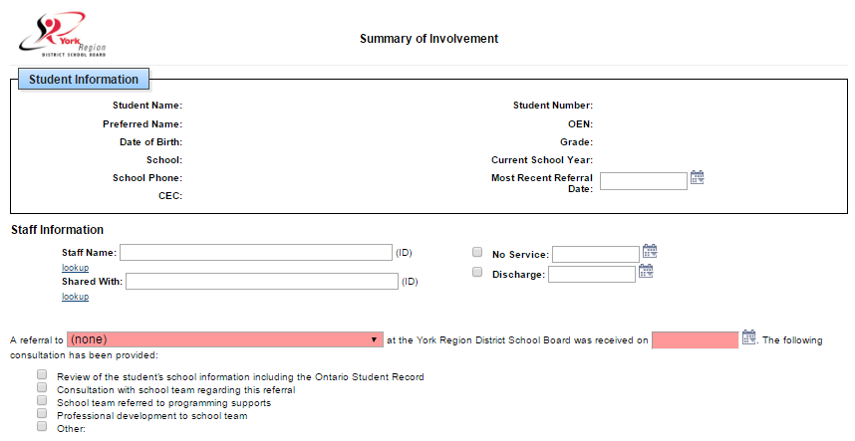
Summary of Involvement

Slide 24
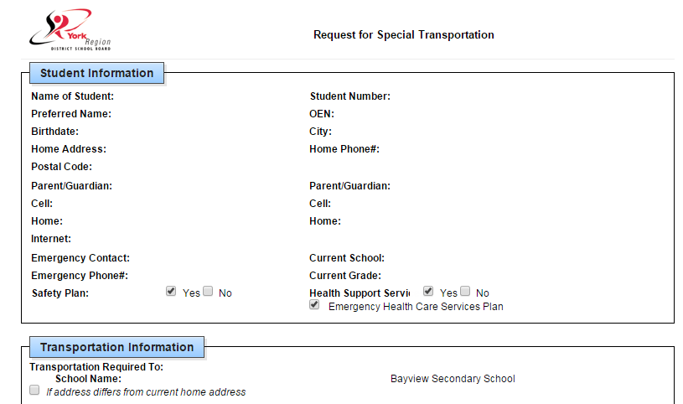
Special Transportation
Notes:
Easy, secure, connect with our transportation partners – includes safety plan and medical care plans.
Ease of management
Routes and times visible by parents, teachers, admin in TieNet

Slide 25
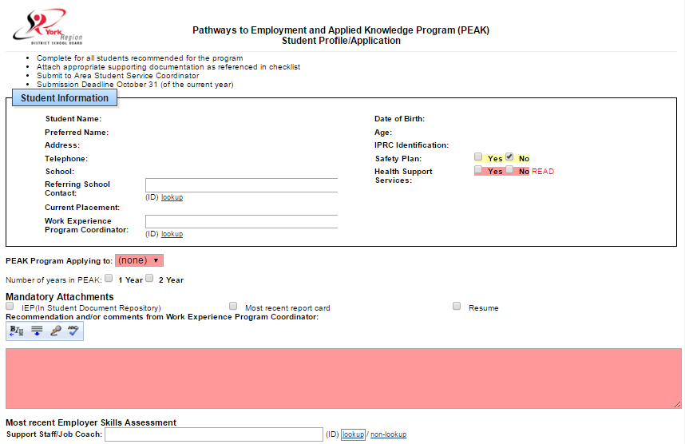
Work Experience

Slide 26
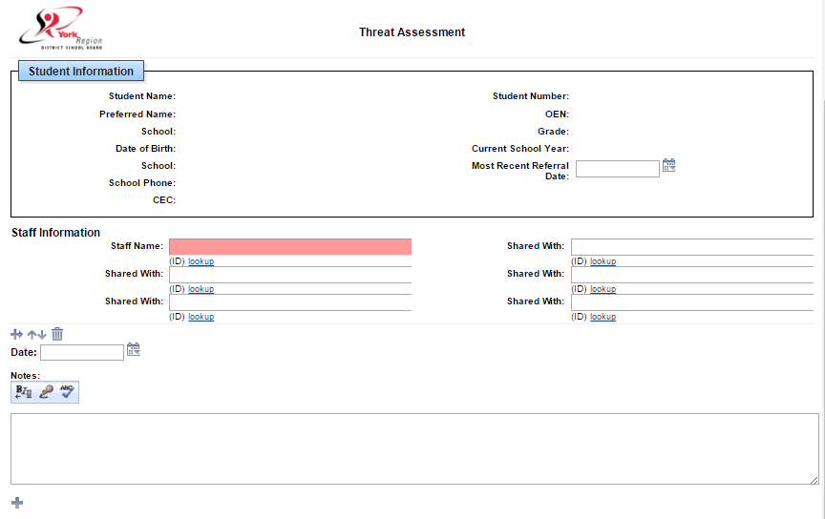
Threat Assessment

Slide 27
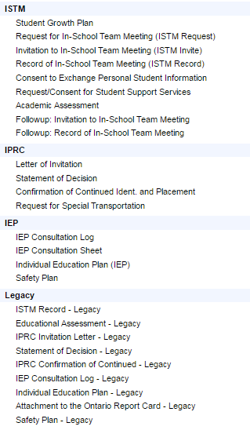
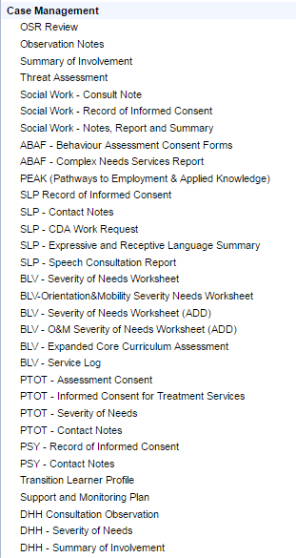


Slide 28
Thank you!

