Slide 1





Respecting Differences: A Whole School Approach to Creating Safe, Caring and Welcoming Environments Through Social Justice and Social Responsibility.
Steven Charbonneau
Patrick Carney
Winnipeg July 2016

Slide 2



Respecting Differences
Walking Together and
Sharing our Stories

Slide 3
Strategic Priorities
Improving Student Achievement and Well Being:
Goal #4 - To promote a culture that values and supports the whole child in spiritual, social, emotional, intellectual, and physical development

Slide 4
Respecting Differences
Student population: 20,000
Schools: 42 Elementary, 9 High Schools
Equity and Inclusion:
A highly integrated approach ensures that the needs of students are always first and foremost as each school community develops and implements their whole school approach to supporting students.

Slide 5
Respecting Differences
The ultimate responsibility in creating truly inclusive communities is to learn about the needs of those who feel marginalized, and to respond to these needs.

Slide 6
The Approach:
Multidisciplinary Committee (Curriculum, Special Education, Faith Life, Psychology, Safe Schools, Mental Health, FNMI Education)
Integrated and Consistent Messaging with curriculum and system messaging
Principal and Vice Principal Meetings
Respecting Differences PD for School Teams - 5 yrs
Youth Symposia – 4 yrs
NOTE: each school community develops and implements their whole school approach to supporting students.

Slide 7
Currently, special focus is placed on students with Mental Health needs and students of FNMI background as we use the locally developed resources Well Aware: Developing Resilient Active and Flourishing Students and Making Good Tracks to ensure that students see themselves reflected in the curriculum and to raise system awareness of the recommendations of the Truth and Reconciliation Report and the overarching importance of Positive Mental Health to student achievement.

Slide 8
Goal of Accepting Schools Act
All students should feel safe at school and
deserve a positive school climate that is
inclusive and accepting, regardless of:
race, ancestry, place of origin, colour, ethnic origin, citizenship, creed, sex , sexual orientation, gender identity, gender expression, age, marital status, family status, or disability.

Slide 9
What are some things we know about students with With Mental Health Challenges?
Stigma is a significant barrier for seeking help, especially for youth:
60% of people with a mental health problem will not seek help for fear of being labeled
Many say the stigma they face is worse than the illness itself
Only 1 in 4 youth with a MH problem seek and receive treatment
          Source: “Well Aware”

Slide 10
What are some things we know about First Nation, Métis and Inuit students?
The effects of colonization and forced assimilation continue to cause acculturative stress and marginalization.
When effects such as these are passed on from one generation to the next it is referred to intergenerational trauma.
Legitimizing FNMI cultural history, practices, and understandings of health and wellness play a critical role in developing well being. Students must see themselves reflected in the curriculum!
Source: “Well Aware”

Slide 11
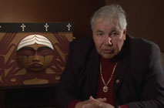
Truth and Reconciliation
A Call to Action
https://vimeo.com/25389165

Slide 12
TRUTH
means…
Understanding that the past and present are connected
New understandings about our shared history – a truth we didn’t know
RECONCILIATION involves…
Strength to know and learn about the suffering
Strength to forgive the unforgiveable
A new relationship with Indigenous Peoples in Canada

Slide 13
Working Together to Support Student Well-being and Achievement with benefits for all…
Ontario First Nation, Métis and Inuit Education Policy Framework
Equity and Inclusive Education
Ontario Curriculum Expectations
Education Services Agreements / Tuition Agreements
Truth and Reconciliation Recommendations
Canadian School Board Charter of Commitment to FNMI Education
CWL Resolution FNMI Youth / Relationship Building
OCSTA Charter of Commitment to FNMI Education / Simoce
Muskoka Catholic DSB Presentation at April AGM

Slide 14
An Overview of the Charter of Commitment
The Canadian School Boards Association Charter of Commitment to First Nation, Métis and Inuit Education as adopted by OCSTA serves as a gateway for provincial school boards to form new relationships and understandings - a foundation to improving outcomes for First Nation, Métis and Inuit students with benefits for all involved in the delivery of education. The Charter outlines nine goals as follows:
1. Respectful and Welcoming Learning Environments
2. Respectful and Inclusive Curriculum and Classroom Programs

Slide 15
3. Culturally Responsive Pedagogy
4. Valuing First Nation, Métis and Inuit Expertise
5. Culturally Responsive Assessment
6. Affirming, Revitalizing the Languages of Canada’s First Peoples
7. First Nation, Métis and Inuit Representation in Staff and Leadership
8. Non-Aboriginal Learners Foster Commitment to First Nation, Métis
and Inuit Education
9. Research

Slide 16

New Understandings - A Shared History
One treaty kit distributed to every
elementary and secondary school
in January 2016.
A range of activities and resources have
been infused in the implementation of
Our Faith ~ Our Future and the Ontario
Curriculum to promote:
past and present contributions
authentic voice
deeper cultural understandings

Slide 17
What are some things we know about LGBTQ students?
Highly rejected LGBTQ young people:
More than 8 times likely to have attempted suicide
Nearly 6 times as likely to report high levels of depression
3 times as likely to use illegal drugs
(Source –Family Acceptance Project)

Slide 18
What are some things we know about Refugee, Newcomer and ELL students?
Key issues that some may face include:
Pre-migration trauma, exposure to violence, and prolonged separation from family members
Economic disadvantages (such as parental unemployment), social exclusion, isolation, racism, discrimination and cultural pressures
Barriers to accessing health care (e.g., language, cultural factors, discrimination, mistrust).
Source: Well Aware

Slide 19
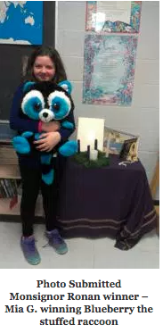
Story about Blueberry
https://youtu.be/UpG5HgqZR6M
Newcomer video

Slide 20
What do we want for our students?
Positive Mental Health….
The capacity of each of us to feel, think and act in ways that enhance our ability to enjoy life and deal with the challenges we face.
It is a positive sense of emotional and spiritual well being that respects the importance of culture, equity, social justice, interconnections and personal dignity.
Public Health Agency of Canada , 2006

Slide 21
Well Being Model
Experiences of:
Positive Emotion
Engagement
Relationship
Meaning
Accomplishment
(Seligman)
Resilient
Social-Emotional
Learning Skills to:
Self Regulate
Flourishing
Relationship
Lifestyle Balance through:
Fitness
Sleep
Nutrition
Spirituality
Active
  Carney, 2015 “Well Aware”
Notes:
Speakers Notes:
This is an evidenced-informed and comprehensive model for POSITIVE MENTAL HEALTH.
Schools are involved in many activities to promote the learning of skills for RESILIENCE, FLOURISHING AND BEING ACTIVE
On Today’s PA day we are going to really focus on the aspect of ACTIVITY for promoting MENTAL HEALTH

Slide 22
Students (and adults) with a sense of well-being feel:
  Able to cope with adversity - are emotionally resilient
  Physically well, nourished, and active
  Physically, psychologically and culturally safe
  Loved, included, valued and supported in home, school, and community
  Competent, academically successful and able to participate in productive activities
  That adults and peers care about their well-being
  That they have a good future

Slide 23
Resilience and SEL:
Social and Emotional Learning Core Competencies
Self-awareness: The ability to accurately recognize your emotions
and thoughts, and their influence on behaviour.
Self-management: The ability to regulate your emotions, thoughts,
and behaviors effectively in different situations.
Social awareness: Showing empathy and understanding for others
Relationship skills: Forming positive relationships, working in teams;
dealing effectively with conflict
Responsible decision making: Making ethical choices about personal and social behaviour
CASEL –
(Collaborative for Academic, Social and Emotional Learning)

Slide 24
Relationship Between Mental Health
and Academic Achievement
A meta-analysis of school-based social and emotional learning programs involving more than 270,000 students in grades K-12 revealed that students who participated in these programs improved in grades and standardized test scores by 11 percentile points compared to control groups (Durlak, Weissberg, Dymnicki, Taylor, & Schellinger, 2011).
*See NASP paper by
Jeffrey Charvat, Director or Research, June 2012
for summary statement of 24 outcome studies.

Slide 25
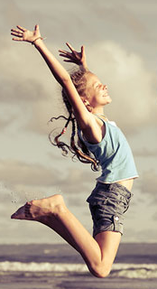
ACTIVE
A student who is:
Physically active – importance of exercise
Well nourished
Getting adequate sleep
Experiencing positive opportunities to fulfill spiritual needs
(which may include active participation in family,
faith-based, cultural, community or personally
enriching experiences)

Slide 26

FLOURISHING
A child who experiences:
Positive emotion (fun, enjoyment)
  Engagement (passionately absorbed; “in the flow”)
Relationships (connection)
Meaning (purpose, spirituality)
Accomplishment (competence)
  These are the 5 elements of Flourishing according to Positive Psychology Research per Martin Seligman

Slide 27
OPTIMAL MENTAL HEALTH
Flourishing
resilient / active / connected / engaged
emotional and spiritual well-being
No Illness Mental Illness
no symptoms serious symptoms
Languishing
(Corey Keys)

Slide 28
Well Being Model
Experiences of:
Positive Emotion
Engagement
Relationship
Meaning
Accomplishment
(Seligman)
Resilient
Social-Emotional
Learning Skills to:
Self Regulate
Flourishing
Relationship
Lifestyle Balance through:
Fitness
Sleep
Nutrition
Spirituality
Active
  Carney, 2015 “Well Aware”
Notes:
Speakers Notes:
This is an evidenced-informed and comprehensive model for POSITIVE MENTAL HEALTH.
Schools are involved in many activities to promote the learning of skills for RESILIENCE, FLOURISHING AND BEING ACTIVE
On Today’s PA day we are going to really focus on the aspect of ACTIVITY for promoting MENTAL HEALTH

Slide 29

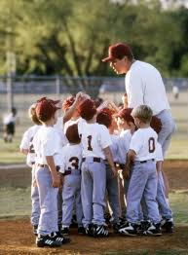
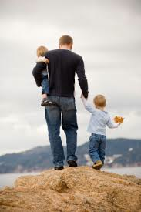
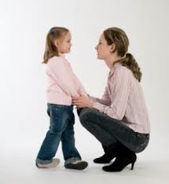

RELATIONSHIPS
with caring adults:
Parents
Teachers
Relatives
Faith-based
Coaches
Others………

