Slide 1
#HWDSB
Igniting Student Voice & Engagement in a School District
Jamie Nunn,
Superintendent of Student Achievement,
Hamilton-Wentworth District School Board
Jnunn@HWDSB.on.ca

Slide 2
LISTENING TO OUR FUTURE LEADERS…
THEY are our FUTURE LEADERS; therefore, we need to give our students the opportunity to provide their voice to shape their future.
AGENDA:
Welcome to HWDSB
Student Voice at the School and System Level
What did we learn?
Student Voice Toolkit

Slide 3
Room Shake: Think, Pair Share
What does ‘student’ voice and engagement currently look like, sound like, feel like in your school board or district?
Reflecting upon the Graffiti Wall

Slide 4
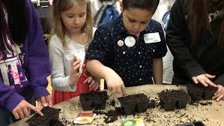
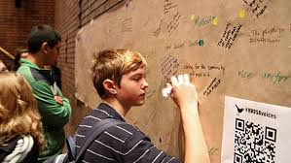
HWDSB
Learn more at www.hwdsb.on.ca or follow us on Twitter @hwdsb

Slide 5
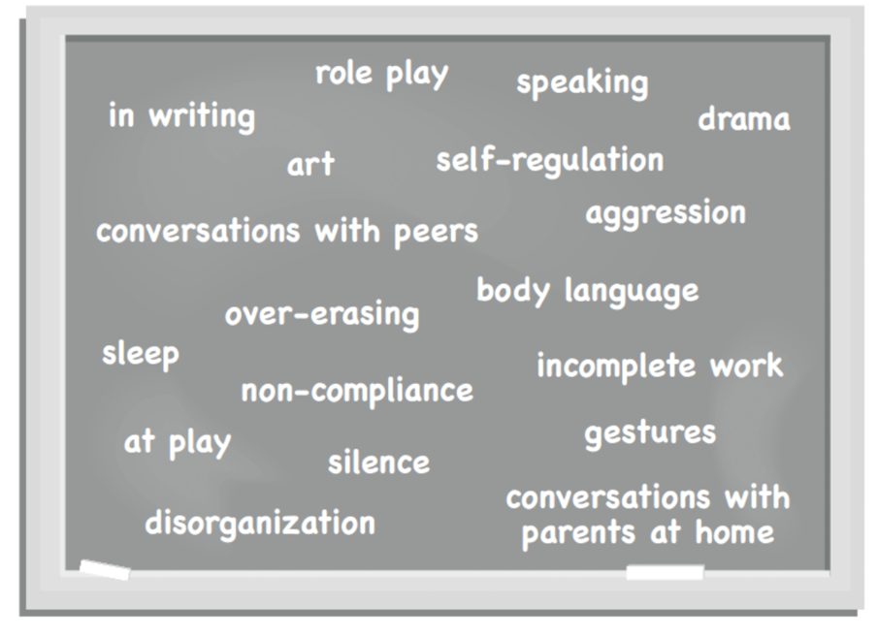

Slide 6
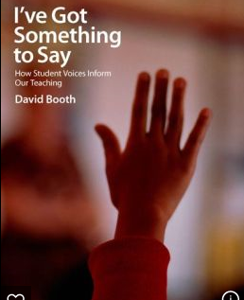
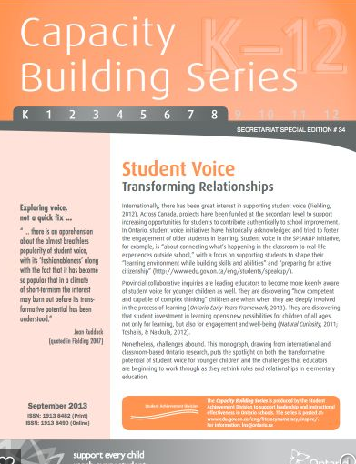
Our Research…

Slide 7
OUR JOURNEY
Implementing our vision, ‘Transforming Learning Everywhere’: strives to develop relationships, classroom environments and learning opportunities between teachers and students.
Student voice, engagement and social justice are embedded into every classroom
Strategies have varied; extensive professional development with school administrators

Slide 8
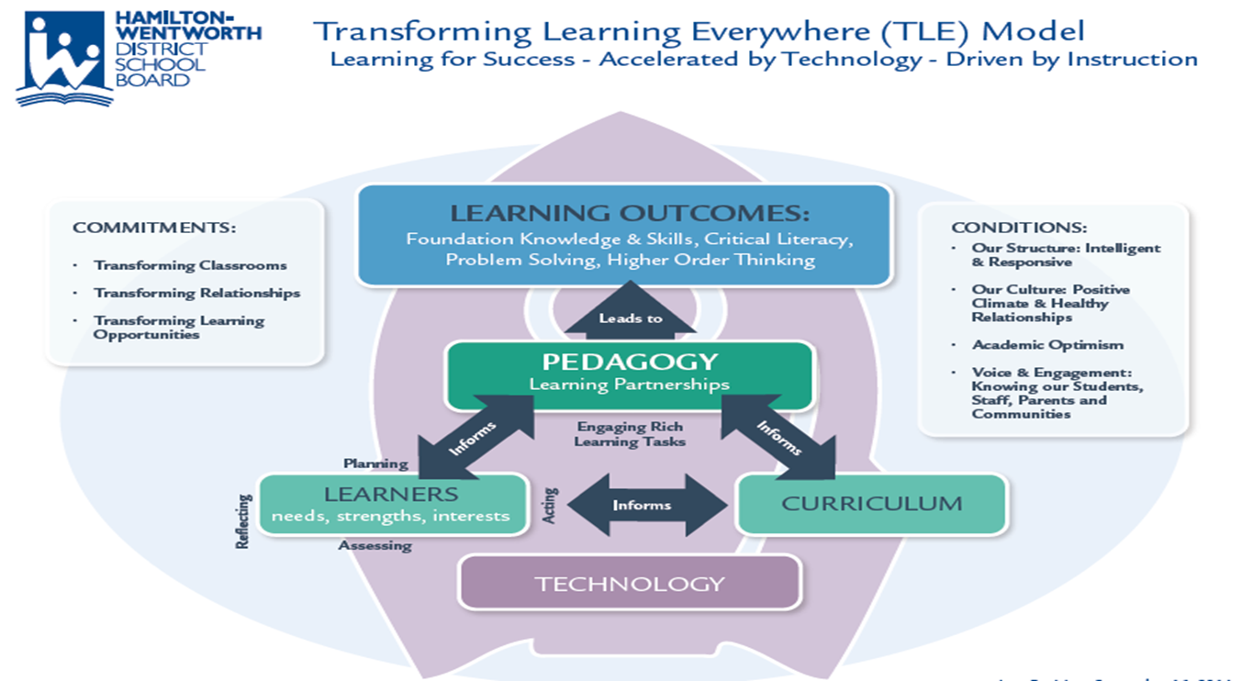
TLE

Slide 9
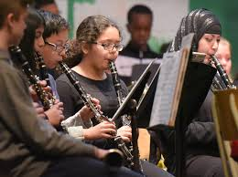
Student Voice at the System Level:
2 Student Trustees, Student Senate
Director’s Student Voice Forums
Development of new HWDSB Tagline: Curiousity, Creativity, Possibility
Innovation Challenge

Slide 10
Our Evolution: From System to Schools
3 System Student Voice Forums (Nov. 2011, Nov. 2012, Feb. 2014);
1st Forum: Student Driven (Qs chosen by students)
2nd Forum: Inform Direction (System Qs)
3rd Forum: Intellectual Engagement - Focus on Learning & Transitions
Workshops for teachers offered
Notes:
Aaron

Slide 11
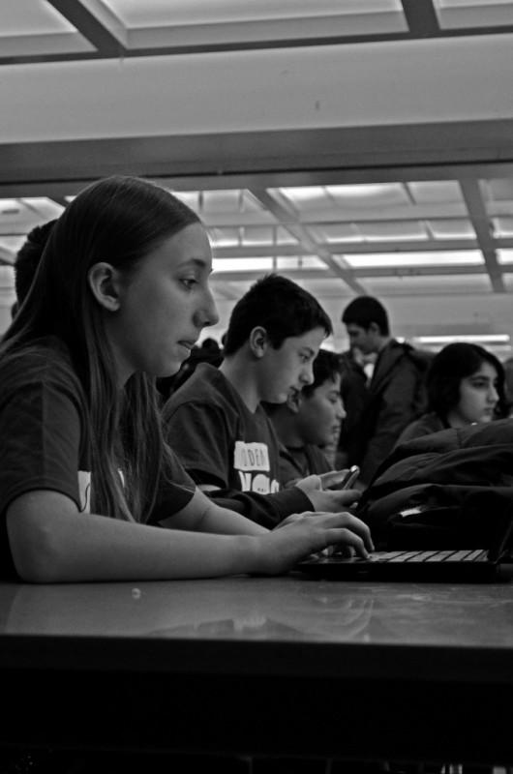
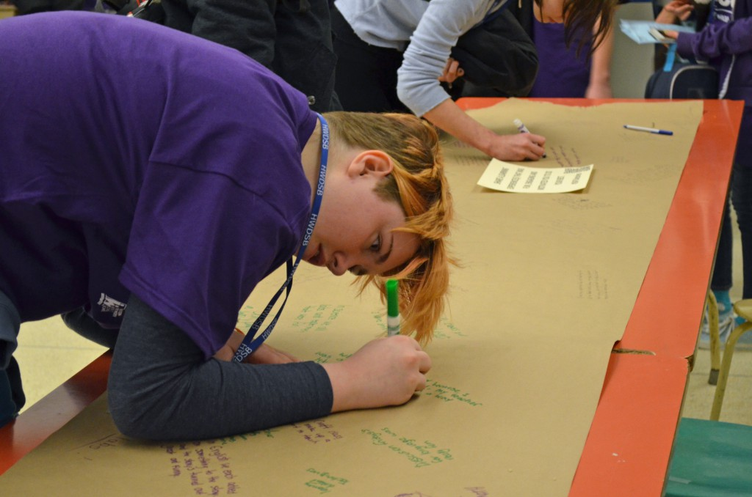
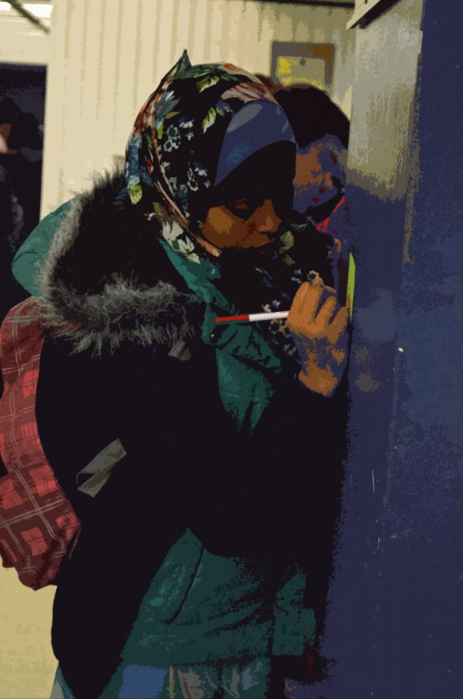
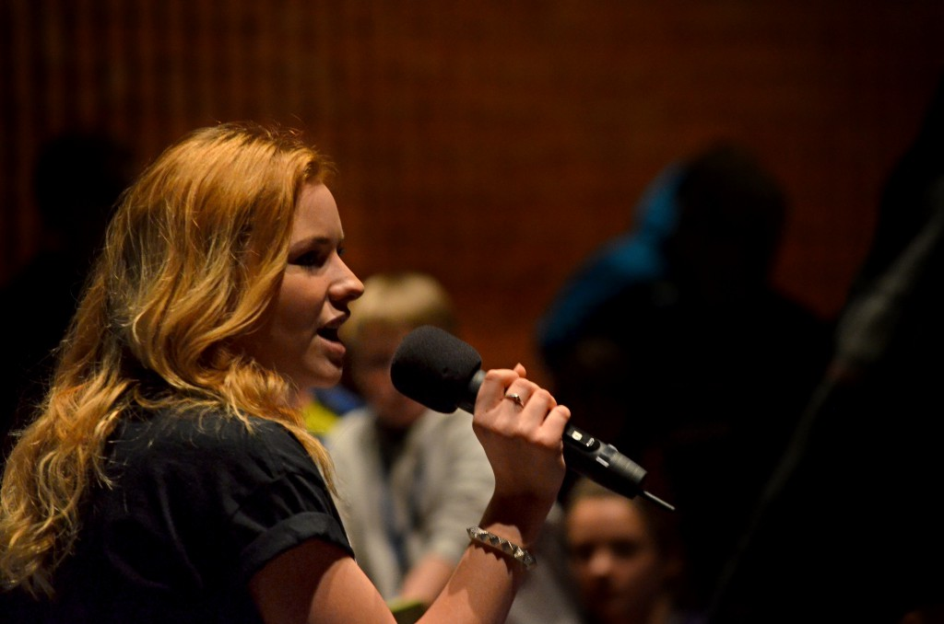
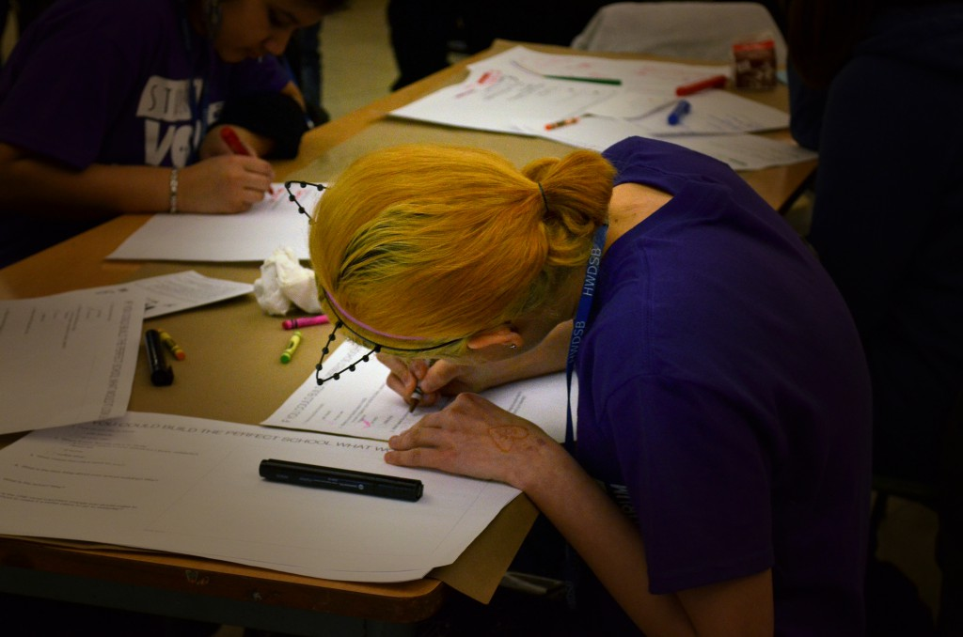

Slide 12
Where We’ve Been: From System to Schools
Transition experiences (Ancaster Senior → Ancaster High, Gatestone → Saltfleet, DVSS)
Sherwood - French Immersion (Before / After)
K-12 Leadership and Learning team - how can system staff support student voice in the work they do with schools and classrooms?
Student Voice Toolkit
Training for School Administrators; A PART of your School Action Plans
After School Sessions to support the Student Voice Toolkit
Notes:
Aaron
Transition to sharing how we’ve assessed our effectiveness, impact, and next steps - CBS - Tranforming Relationships tie in to TLE)

Slide 13
Room Shake: Think, Pair Share
How is student voice gathered at your ‘system level’ to inform decision-making?
What future possibilities do you see to use student voice at a system level?

Slide 14
Student Voice at the School Level:
Student Voice Option Sheets/Course Selection
‘Student Voice’ Forums (Focused Topic)
Social Media (Twitter: Question of the Week)
School Inquiry: Commitment to social justice initiatives

Slide 15
TOGETHER WE CREATE CHANGE
What does it LOOK like in HWDSB? Meet some of our students…
https://drive.google.com/a/hwdsb.on.ca/file/d/0B_XdEOPvOOCQYThEYnVaLUdfbVU/view

Slide 16
Room Shake: Think, Pair, Share
How is student voice gathered at your ‘system level’ to inform decision-making?
What future possibilities do you see to use student voice at a system level?

Slide 17
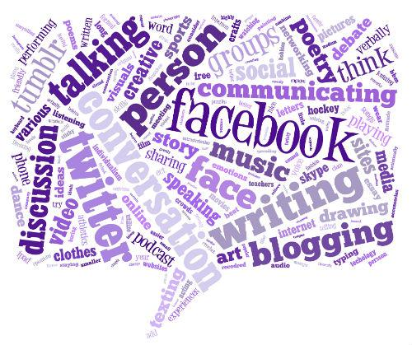
Students shared with us that relationships (teacher & peer) were the most important part of their school experience.
Relationships are key!
Although our students’ voices were vital to system understanding & direction, they spoke the most about their school and classroom experience.
Student Voice is a powerful tool for school improvement planning and planning for classroom instruction and course delivery.
How do we move student voice into daily teaching & learning experiences?
Student Voice Toolkit
Notes:
During registration, we polled the students on how they preferred to express themselves. The first choice was Facebook and the second was Twitter. Facebook, blocked by our board as it is many others, was not an option but Twitter was and is. We added this form of expression to the 2nd Annual Forum.

Slide 18
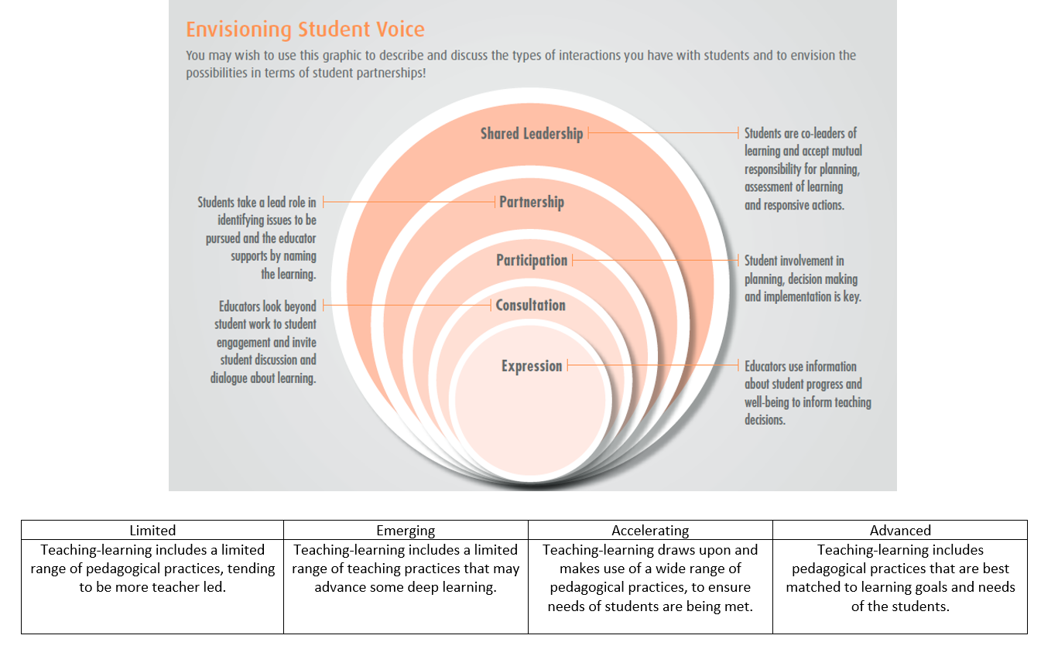
Envisioning Student Voice: Self Assessment
Notes:
Brian - Move towards Student Voice as a ‘weather’ event to part of our culture (or climate) and what we do daily to engage students and support achievement and well-being.
- What tools can we use to determine where we have been, where we are, and what is possible by leveraging student voice and partnering with students? 5 minutes for reflection.

Slide 19
Student Voice Toolkit
Tools and Strategies to Collect Voice:
Using a Blog space
Graffiti Walls
QR (Quick Response) Codes
Classroom discussions
Whole School Forums

Slide 20
Helpful Hints: What makes a question ‘good’?
Questions that are too general:
Do students feel safe at school?
Questions that are too specific:
Will having teachers in the halls during break help students to feel safe?
Balanced questions:
Under what conditions do students feel safe and welcome at our school?

Slide 21
The Toolkit introduced teachers to a framework to move student voice into action:
Step 1: How do gather/analyze data?
Step 2: Implementation (Data Collection)
Step 3: Analyze
Step 4: ACTION

Slide 22
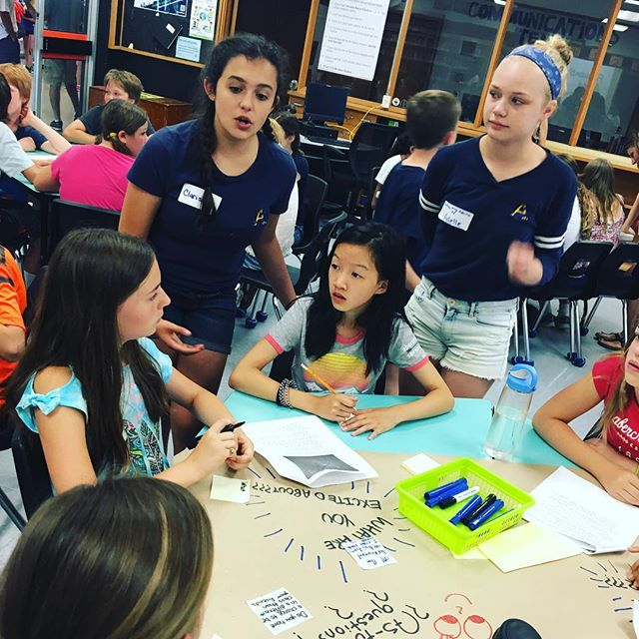
Room Shake: Think, Pair, Share
What have you heard that has intrigued you?
What are your next steps to initiate student voice in your classrooms and districts?

